Slide 1
COPAC: Policy & Caims copilot
Presented by: Sahana Vallem
An AI Assistant that gives accurate policy answers and pre checks claim before submission

Slide 2
Problem Statement:
Use case: “Policy & Claims Copilot” (Customer support + Claims pre-check)
Goal - Help customers, agents, and claims teams get instant, consistent answers about:
What’s covered / not covered
Limits & sub-limits
Waiting periods
Claim submission steps + timelines
Documents needed
Also do a pre-check of a claim scenario before submission.
This reduces call center load, speeds claim filing, and improves first-time-right submissions.

Slide 3
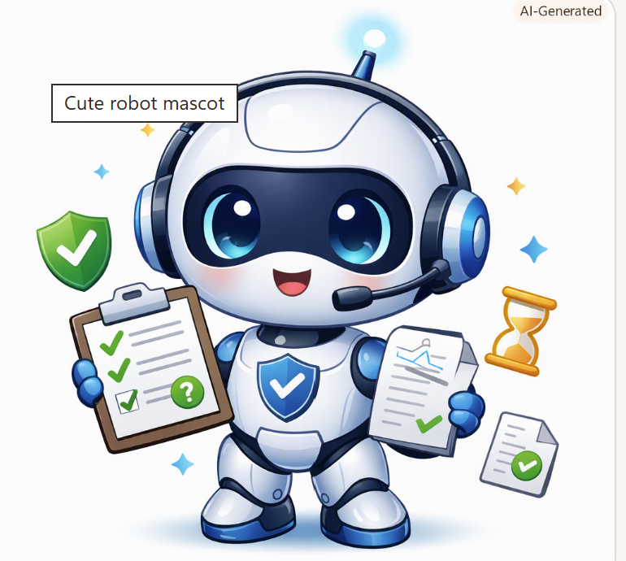
Project Goal:
The goal is to build an AI Assistant /Copilot which can help answer customer with all policy related queries and perform a claim-pre check before submission.

Slide 4
Solution Overview:
This copilot is developed to help with hospitalization claims queries and pre-check the claims. This copilot architecture includes the following:
LLM : Open AI (gpt-5-mini)
To understand user query.
Embeddings: Embeddings are created using Open AI Embedding model:text-embedding-3-small
FAISS : META(Facebook AI Similarity Search)
IndexFlatL2: perform Bruce Force Search perform search by comparing each word against all the available words. Fast vector search.
Metadata: FAISS saves the word vectors in its index. Respective text/chunks need to be stored in order to retrieve the information. Metadata is where the text/chunks exists.
RAG : Retrieve correct policy text/chunks.

Slide 5
COPAC(Co-pilot) Architecture:
Open AI LLM
PDF File
Embedding Model
Vectors
FAISS(index & Vector). Metadata.Json(Text)
User Query
RAG Response

Slide 6
FLoW:
Below is the FLOW of the Copilot:
Generated Policy & Claims Knowledge Base PDF.
Read Data from PDS to pdf_text List and chunked the data.
Created word embeddings using OpenAI embedding mode: text-embedding-3-small
Saved the word vectors into FAISS and the text to Metadata.json file.
Calling Open AI LLM Model gpt-5-mini model to use as LLM for this Copilot.
Once user enters the Query the query is converted to vectors and the matching data chucks are passed as context to LLM.
LLM then curates the response based on the retrieved data and provide the response to the User.

Slide 7
User QuerY and CopAc Response

Slide 8
Query-1:
Your Query: How to raise a claim?
Copilot_response: Steps to raise a claim
1. Notify the insurer or TPA (Third Party Administrator) as soon as possible.
2. Submit the claim form (online or offline).
3. Provide the required documents.
4. Undergo the claim assessment.
5. Receive the approval or rejection decision.
Types of claim settlements - Cashless claims: Direct settlement with a network hospital. - Reimbursement claims: You pay upfront and claim the costs later. Note: Make sure your policy is active and any waiting period (if applicable) has been completed.

Slide 9
Query-2:
Your Query: How to raise a cash-less claim?
Copilot_response: Steps to raise a cashless claim (using only the provided context)
Use a network hospital — cashless settlement is available only at network hospitals.
Notify the insurer or TPA (Third Party Administrator) as soon as possible.
Submit the claim form (online or offline) to the insurer/TPA or hospital as instructed.
Provide the required documents.

Slide 10
Query-3:
Your Query: What documents do I need for a car accident claim?
Copilot_response:
Typical documents (for an accident claim) from the provided policy context:
Duly filled claim form
Hospital bills and receipts
Discharge summary
Important procedural notes from the same context:
Intimate the claim within 24–48 hours of hospitalization.
Submit documents within 7–15 days after discharge.
Missing documents may delay or lead to rejection of the claim.
Claim processing typically takes 15–30 working days; reimbursement (after approval) is settled within 7–10 days.

Slide 11
Conclusion:
COPAC Copilot/AI Assistant – Key Benefits:
Reduced work Load for Call Centers.
Accelerates the Claim process.
Reduce long waiting for Customer as this Copilot can assist with raising the right claim.
Improves the first‑time-right submissions.
Provides Rates, Limits, Required Documents.
Outlines Claim submission steps & timelines

Slide 12

Thank you
Sahana Vallem
SAP ID: 51813822
EmailID: Sahana.Vallem@HCLTech.com

